Slide 1
Multimedia operating System

Slide 2
Outline
Resource Management
Process Management
Scheduling Strategies
Prototype System

Slide 3
Multimedia Operating System
OS shields the computer hardware or devices against all software components
For multimedia applications not only transferring data has to be considered – also, the processing of the data on sender and receiver host has to be fast such that human perception is natural and error-free..
Most conventional operating systems offer only little or no support for in-time processing of continuous media.
MOS concerns all functions of an operating system like process, memory, file or device management

Slide 4
Operating System Aspect
Resource Management
How to achieve a coordinated processing of all operating system functions in order to achieve an end-to-end Quality of Service (delay, capacity, loss rate, jitter, ...)?
An abstract continuous resource model
A common resource management procedure
Process Management
How to schedule processes permitting each to terminate according to its deadline?
Rate Monotonic Scheduling
Earliest Deadline First

Slide 5
Operating System Aspect
Communication & Synchronization
For real time applications where there is timing relations among different media , communication and synchronization between single process is required.
Memory Management
For accessing data with guaranteed timing delay and efficient data manipulation functions, memory management , buffer management operations should be used.
Database Management
This abstracts the details of storing data on secondary media and rely on file management services provided by MOS.
Device Management
Device Management ensures integration of continuous and discrete media and shield devices from software applications.

Slide 6
Real-Time Systems
What means real-time?
A real-time task is a process which delivers its result in a given time or according to a given deadline. A deadline is given e.g. in the order of msec for interactive voice and video data or in the order of days for text documents.
What means the term deadline?
A deadline represents the latest acceptable time for finishing the processing of a task.
Deadlines are called hard if failures are mission-critical or threatening human beings.
Deadlines are called soft if they cannot exactly be determined or a violation is less critical.
Fields of application
Control systems for manufacturing processes, military systems, telecommunication
systems, aircrafts, automobiles, nuclear power plants or interactive multimedia systems.

Slide 7
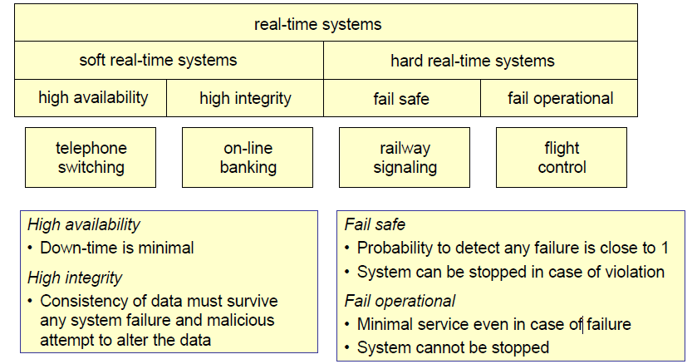
Classification of Real-Time Systems

Slide 8
Real-Time Systems
Processing Requirements
Predictable fast response to time-critical events
Accurate timing information
High degree of schedulability, i.e. resource capacity is not wasted (nearly optimal scheduling; finding optimal schedules is often a NP-complete task)
Stability under transient overload, i.e. use of buffering to cope with bursty systems
Aspects specific to Multimedia Systems
In-time processing, transmission and presentation of audio and video data
Requirements are described as QoS parameters
Throughput, local delay, global (i.e. end-to-end) delay, jitter, and reliability
Specified by average values, worst case values, peak rates, distribution functions, and/or moments of the distribution functions
→ Resource Management and Process Management for dealing with deadlines

Slide 9
Resource Management Tasks
Admission control
If a new data stream wants to start:
is there enough remaining capacity to handle the additional stream?
2. QoS calculation
Which characteristics (e.g. in terms of throughput and delay) are available for the new stream?
3. Resource reservation
Reserves the resources which are required to meet the deadlines
4. QoS enforcement
Quality of service can be (possibly) obtained by appropriate scheduling, e.g. by reordering tasks (serving a tasks with urgent deadlines earlier than a task with less strict bounds)

Slide 10
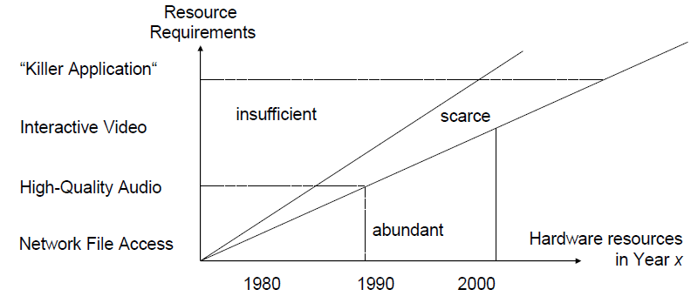
Resource Management
Fig: window of insufficient resources.
Even sophisticated compression techniques cannot compensate resource bottlenecks
• In current (interactive) multimedia systems, capacity is necessary for audio and video transmission as well as processing power

Slide 11
Classification of Resources
Active vs. passive resources (depending on their autonomous processing capabilities)
Active resources: CPU, network interface card, etc
Passive resources: file system, main memory, etc
Shared vs. exclusive resource usage
Active resource are usually allocated exclusively whereas passive ones can be shared by multiple tasks
Single vs. multiple resource occurrences
A “normal” workstation for a human user usually contains only a single CPU, whereas many servers contain two or more CPUs

Slide 12
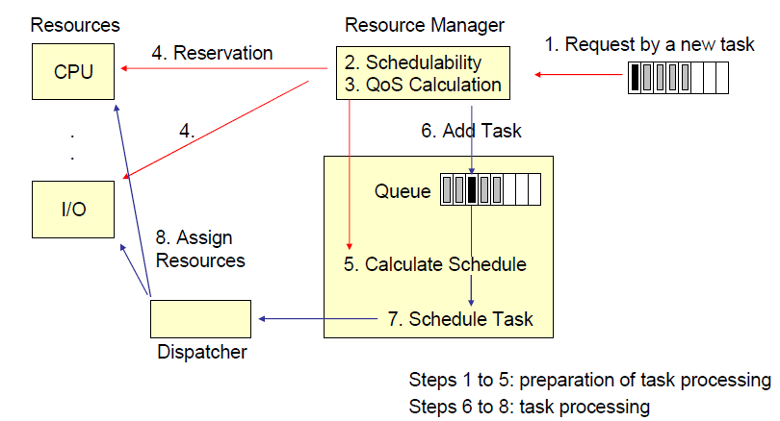
Resource Management Procedure

Slide 13
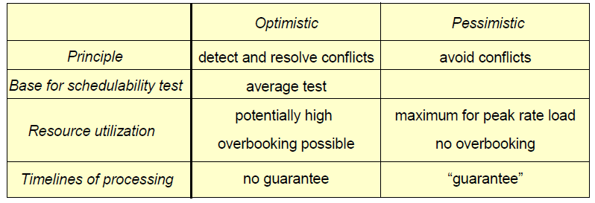
Reservation Strategies
Northwest Airlines
Risky, lots of overbooking, solve conflicts by finding customers who leave the aircraft (by paying something in cash or – better – in terms of a voucher)
Lufthansa
very cautious airline (no
overbooking, no-shows), low actual load, high prices
Airline Example

Slide 14
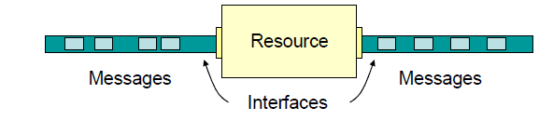
Abstract Continuous Media Modeling: Workload
Data streams consist of periodically arriving Logical Data Units (called Messages) and are described by the “Linear Bounded Arrival Process (LBAP) Model”
A data stream is a triple (M, R, B), where
M is the maximal message size
R is the maximal message rate (i.e. the number of message per time unit)
B is the maximal burstiness or allowed work ahead
The model is named linear bound arrival process because it assumes that the number of message arrivals N in a given time interval Δ is bound by
N (Δ) = R · Δ + B (R · Δ message arrivals in Δ time units)

Slide 15
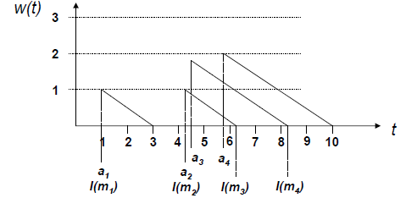
Abstract Continuous Media Modeling: Workahead
The workahead w(t) of a LBAP at time t describes how many messages have arrived that are not yet processed. It is defined by w(t) = max {0, N( [t₀, t] ) - R ⋅ |t - t₀|}.
The logical arrive time l(m_{i}) of message m_{i} is the time at which a message is effectively being scheduled. The scheduling is done by FIFO (First In, First Out). The logical arrival time then is defined by
l(m_{i}) = a_{i} + w(a_{i}) / R (= actual arrival time + delay due to workahead)
l(m_{i}+1) = max {a_{i}+1, l(m_{i}) + 1 / R}
where a_{i} is the actual arrival time of message m_{i}

Slide 16
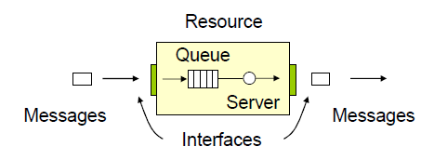
Abstract Continuous Media Modeling: Resources
The logical delay d(m) of messages m between two interfaces I₁ and I₂ is defined by
d(m) = l₂(m) - l₁(m)
The buffer requirements of resource for a given data stream are defined by
buf = B + R·(D - U) with
B = number of messages which arrive unexpectedly due to burstiness
D = maximum logical delay between input and output interfaces
U = minimum (unbuffered) actual delay between the same interfaces
R·(D - U) = number of messages

Slide 17
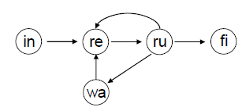
Process Management
Process Management deals with the assignment of the CPU to processes/tasks. A process may be in one of five basic states:
initial, i.e. it is created, but not in schedule; process is idle
ready, i.e. it is waiting for CPU assignment
running, i.e. it is running on the CPU
waiting, i.e. it is waiting for an external event
finished
A scheduler chooses the next process to become running according to a given schedule.
The schedule determines the order of CPU assignment to processes.
Goals of traditional scheduling
Optimal throughput, optimal resource utilization, fair queuing
Goals of real-time scheduling
Execute maximum number of processes in time, i.e. according to their deadlines
Minimize deadline violations

Slide 18
Classification of Real-Time Scheduling Strategies
Scheduling strategies can be distinguished by...
static vs. dynamic schedule calculation
(static = calculation of schedule in advance dynamic = re-calculation whenever a new task arrives)
central vs. distributed schedule calculation
preemptive vs. non-preemptive task processing
(preemptive = a task may be interrupted by any task with higher priority)
They schedule...
tasks with periodic or aperiodic processing requirements
independent tasks or tasks with precedence constraints
They are applied to...
uniprocessor systems
multiprocessor systems (neglecting communication delay)
multicomputer systems (taking communication delay into account)

Slide 19
Schedulability Tests and Optimal Schedulers
The test to determine whether a schedule exists for a given task set is called a schedulability test
There are three kinds of test: sufficient, exact, and necessary ones:
Sufficient test: if the test is positive, the set of tasks is schedulable. A negative result is possible even if the task set is schedulable (“cautious” test).
Necessary test: if the test is negative, the set of tasks is not schedulable. A positive result does not guarantee the schedulability of a task set (“optimistic” test).
Exact test: if the tasks set is schedulable, it returns a positive result.
Most exact schedulability tests belong to the class of NP-complete problems
A scheduler is called optimal if it always finds a schedule for task sets satisfying an exact schedulability test

Slide 20
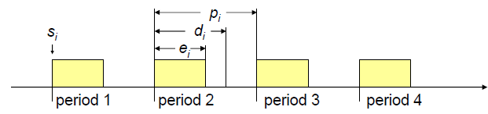

Model for Real-Time Tasks
A task is characterized by its timing constraints and its resource requirements
Most tasks in multimedia systems are periodic and have no precedence constraints
Model for a task timing constraint: (s_{i}, e_{i}, d_{i}, p_{i}) with
s_{i} starting point, i.e. ready time for first period
e_{i} processing time for period pi
d_{i} deadline for period pi (relative to its period’s ready time)
If a task set consisting of periodic tasks (T₁, ..., T_{n}) is schedulable [T_{i} = (s_{i}, e_{i}, d_{i}, p_{i})], then
the processor utilization is given by
(where e_{i}/p_{i} = relative processor
utilization by task T_{i})

Slide 21
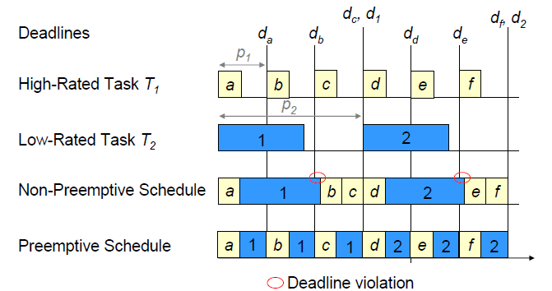
Preemptive vs. Non-Preemptive Scheduling
There are tasks sets that have valid preemptive schedules but no non-preemptive ones. If the cost for preemption is neglected, preemptive scheduling is always better or equal than non-preemptive scheduling.

Slide 22
Rate Monotonic Algorithm
The Rate Monotonic Algorithm (RM) is a static, preemptive algorithm for periodic tasks
Assumptions
All time-critical tasks have periodic computing requirements
Tasks are mutually independent (i.e. no precedence constraints)
A task’s deadline equals its period (d_{i} = p_{i})
A task’s maximum computing time is constant and a-priori known
Context switches are considered timeless, i.e. preemption is assumed to come without cost (at least without time cost)
Principles
Shortest period ⇔ highest priority (i.e. tasks are ordered by decreasing period)
Priorities are recalculated if a new task is added to the task set or a task is deleted from the task set (schedule calculation only once for a given task set)
RM is optimal among static scheduling algorithms, i.e. if a task set is schedulable by any static algorithm then there exists a feasible RM schedule

Slide 23
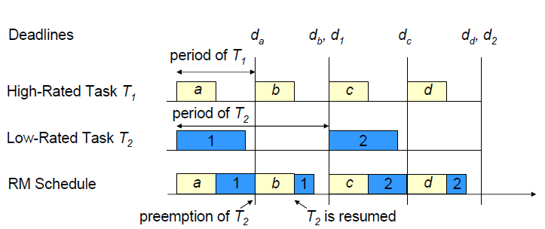
Rate Monotonic Example
Principle of operation: high rated tasks preempt lower rated tasks
The performance of RM depends on the arrival pattern; in the worst case (“critical instant“), every task with higher priority arrives at the same time than a lower rated task (i.e. maximum disadvantage for lower rated tasks)

Slide 24
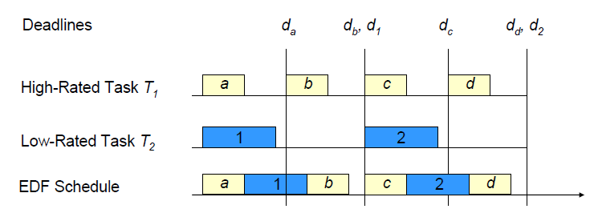
Earliest Deadline First (EDF)
Earliest Deadline First is a dynamic, preemptive algorithm for periodic tasks
Principle of operation:
Earliest deadline ⇔ highest priority
Priorities are re-calculated each time a task becomes ready (even for an unchanged task set)
Calculation has worst case complexity of O(n²)

Slide 25
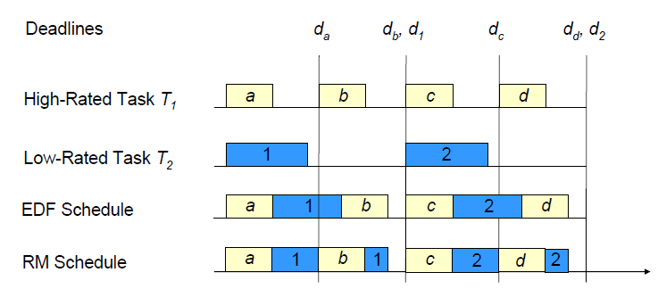
Comparison of EDF and RM
RM schedules require more context switches, i.e. more preemptions, than EDF
The higher number of preemptions for RM has to be compared
with the additional cost for EDF due to recalculation of schedules

Slide 26
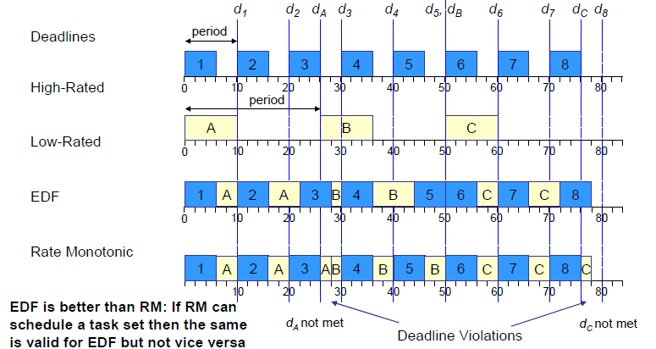
Comparison of EDF and RM
Rate monotonic vs. EDF: Processor Utilization and Deadline Violations

Slide 27
Multimedia File System Architecture
Multimedia Systems must coexist with the conventional Non-Real- Time Environment (NRTE) data processing
→ Many operating systems provide extensions to support multimedia application Real Time Environment (RTE)
Application itself never really touches the data
→ Take the shortest possible path from source to the sink

Slide 28
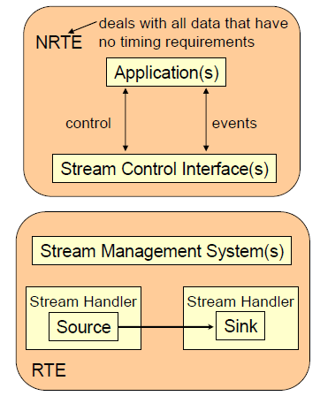
System Architecture
RTE schedules the processes according to the timing requirements
Stream Handlers manage the RTE data flow in accordance with the control operations of the NRTE
Applications access stream handlers by establishing (creating) sessions

Slide 29
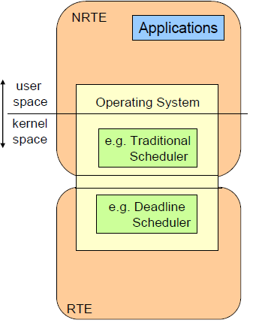
System Architecture : Unix based
Applications make use of systems calls in the NRTE
Extensions to the operating system (i.e RTE) are part of the kernel space

Slide 30
System Architecture - IBM OS/2
• Multimedia Presentation Manager/2 (MMPM/2)
Part of IBM’s Operating System/2 (OS/2)
Well-suited for multimedia supporting preemptive multitasking, priority scheduling, demand-paged virtual memory storage, etc.
• Media Control Interface (device independent programming interface)
Open, close, status of device (for all devices)
Play, record, resume, stop (playback, record)
Set cue point (allows for synchronization)
Get table of contents of a CD-ROM (device-specific command)
Stream Programming Interface
Implementation of data streaming and synchronization
Access to the SyncStream Manager (coordinates and manages the buffers)
Ease of use several levels
Style guide for applications, unified graphical interfaces
Application developers and device providers can integrate their own I/O processes, stream handlers, etc.

Slide 31
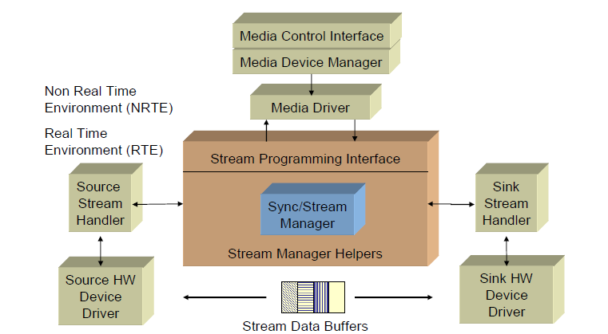
System Architecture - IBM OS/2
OS/2 Multimedia Presentation Manager/2

